Slide 1

Making this resource work for you
Prior to teaching this lesson, please refer to the ‘Unit Overview and Planning Document’.
Further guidance on planning Science Mastery lessons can be found in the detailed planning guidance document.
Refer to the ‘notes’ section on each slide for useful information, including suggested expositions, pedagogical content knowledge, suggested questions, answers and more. Consider using presenter mode so you can see this guidance throughout the lesson.
The introduction slides can be adapted to suit your teaching style and the needs of your class.
Before the lesson, adapt the fix-it slide to address any misconceptions identified in the previous lesson’s exit ticket.
Choose from the suggested activities to suit your class. The intention is not that you complete all of these, but that you select those which ones are most appropriate for your students. It may be appropriate to further adapt activities for your students.
These lessons are designed to occupy approximately 1 hour. To adapt for a shorter or longer lesson duration we advise you to adapt the activity section accordingly.
Please consider using the final slide to send feedback about this lesson or examples of PowerPoints that you have adapted to our design team. Your feedback is used to improve Science Mastery for all of our teachers and students. We appreciate all suggestions and comments.
Thank you for reading!
The Science Mastery Team

Slide 2

Newton’s First Law
Answer the following questions:
Define resultant force.
State Newton’s Third Law.
Explain the difference between speed and velocity.
Name a force that acts in the opposite direction to motion.
Describe the possible effects of an unbalanced force.
The net force or the overall effect of the forces acting on an object.
Every action has an equal and opposite reaction. If object A exerts a force on object B, object B exerts an equal and opposite force on object A.
Speed is the distance covered per unit time and has a size only (scalar), velocity is speed in a given direction and is a vector.
Friction, air resistance, water resistance
An unbalanced force can change an object’s shape, speed or direction.
Notes:
Foundation question: State the SI unit for force.
Answer: SI unit for force is Newtons (N).
Stretch question: Explain how two forces acting at at angle could be resolved to make a resultant force of 0 N.
Answer: They would still have to be acting in opposite directions – i.e. so that the horizontal components and the vertical components would cancel each other out.

Slide 3
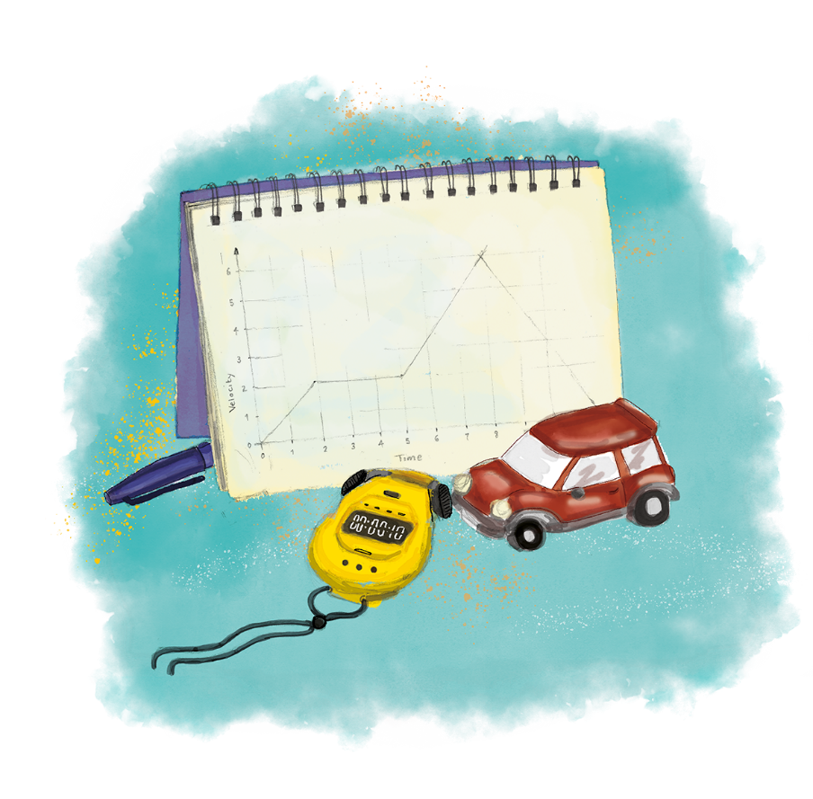


P3.1.6
01/05/2024
Newton’s First Law
P3.1.1 Prior Knowledge Review
P3.1.2 Scalars and Vectors
P3.1.3 Resultant Vectors
P3.1.4 Resolving Vectors
P3.1.5 Newton's Third Law
P3.1.6 Newton's First Law
P3.1.7 Acceleration
P3.1.8 Acceleration Investigation
Maths in Science Lesson 17
P3.1.9 Velocity-Time Graphs
P3.1.10 Velocity-Time Graphs 2
P3.1.11 Acceleration Problems
Notes:
Pupils need to be completely secure in their understanding of calculating resultant force and the difference between balanced and unbalanced forces. They have learned in P1.1 that only unbalanced forces can change the speed, direction or shape of an object so this is building further on this idea. The focus of this lesson is identifying when forces are balanced/unbalanced and identifying the effects of each on stationary and moving objects. This will lead into looking at acceleration and velocity-time graphs, drawing conclusions about the forces acting on an object from their motion.
Hook:
Consider a person cycling at a constant speed of 6 m/s. What can we say about the forces acting on them? Draw a free body diagram of the forces acting on them. Compare this to a free-body diagram of a stationary cyclist.

Slide 4

Following this lesson, students will be able to:
State Newton’s First Law.
Calculate resultant forces.
Predict the motion of objects based on the forces acting upon them.
Key Words:
balanced
unbalanced
resultant
stationary
acceleration
constant velocity

Slide 5
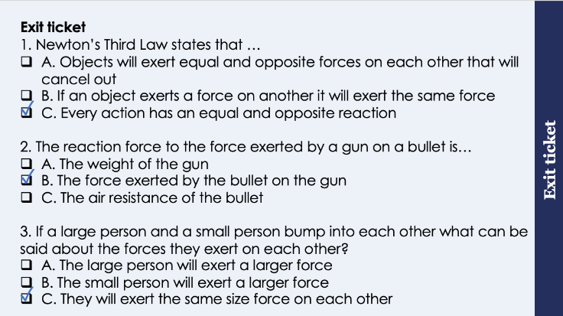
This is the fix-it portion of the lesson
The fix-it is an opportunity to respond to gaps in knowledge, especially those identified by the previous lesson’s exit ticket.
The teacher should customise this slide as needed, to facilitate
reteach, explanation, demonstration or modelling of ideas and concepts that students have not yet grasped or have misunderstood.
practise answering specific questions or of key skills.
redrafting or improving previous work.
Notes:
Suggested Guidance from previous exit ticket:
Q1. Answer: C
If students answered A or B they are not secure on the definition behind Newton’s Third Law. To fix-it, compare N1 and N3 after introducing N1 in the next lesson so pupils have to correctly identify which is which.
Q2. Answer: B
If students answered A or B they have not understood how to identify the action-reaction pair. To fix-it, practice with pupils using the sentence structure ‘when A (e.g. gun) exerts a force on B (bullet), B (bullet) exerts an equal and opposite force on A (gun).
Q3. Answer: C
If students answered A they have not been able to understand this as an example of an action-reaction pair. To fix-it, it may be useful to model a scenario with two objects crashing into each other to show how the force exerted by each object is equal and opposite. It may also be worth elaborating and discussing the effect that this will have on different masses – i.e. why does a bullet shoot away rapidly but a gun recoils much slower (Fnet=ma, if the force is equal but the masses are different, they will have different accelerations).

Slide 6

Forces and Motion
This shopping trolley is stationary.
What is the speed of a stationary object?
What can we tell about the forces acting on the trolley?
What would a free-body force diagram look like for this stationary trolley?
Notes:
Guidance:
This can be used as a quick recap to check that pupils are secure with the idea of stationary objects and the simpler part of N1 (stationary objects will remain stationary).
What is the speed of a stationary object?
0 m/s
What can we tell about the forces acting on the trolley?
The forces must be balanced
What would a free-body force diagram look like for this stationary trolley?
The forces would be equal in size but opposite in direction. The forces acting would just be weight and the normal contact force of the ground on the trolley.
Suggested guidance:
Talk tasks can be used in a variety of ways to suit the particular needs of the students you are teaching. Through exchanging views with others, students develop their understanding of the science beyond what could be achieved individually.
Science classrooms that successfully integrate talk have the following features:
Science talk is a regular feature of lessons and is woven into classroom activities.
Students are paired or grouped strategically by the teacher to ensure productive interaction. This might take into consideration the students’ proficiency of the English language, how encouraging they might be to peers and their attainment in the topic. It’s a good idea to consider these pairings in the class seating plan.
Students are encouraged and supported to talk, but are not forced to talk.
The teacher should take on the role of a facilitator, engaging with conversations where necessary and encouraging or steering the conversation where needed.
Students are encouraged to use the language they have to express their ideas (e.g., everyday language, imperfect English, native language), but also to incorporate science specific terminology where this is more accurate or has been taught.
6. Scientifically inaccurate ideas are not dismissed by the partner or teacher; open discussion and further investigation are relied on to help students construct ideas that support them to progress in their scientific understanding.
7. Guidelines for behaviour during talk tasks are explicit and frequently reviewed. Rules for students might be:
Listen carefully to your partner
Take turns talking.
Speak one at a time, without interrupting.
Politely agree or disagree and explain why.
Politely point out if your partner has used a scientific word incorrectly, if they have explained the science incorrectly, or if there is a more accurate way to describe something.
If confused, ask questions.
Stay focused on the discussion topic.
Respond to one another.
Image source: pixabay

Slide 7

Newton’s First Law
Newton’s First Law states that an object’s motion will not change unless acted upon by an unbalanced force.
The tendency of objects to continue in their state of motion is called inertia.
An unbalanced force is a non-zero resultant force.
If the resultant force is 0 N the forces are balanced and the object is in equilibrium.
Notes:
Exposition type: explanation
Suggested exposition:
There is an old saying that no one likes change, and the same is true in physics! The next of Newton’s Laws that we are going to look at is Newton’s First Law, which is also sometimes referred to as the law of inertia. Newton’s First Law states that an object’s motion will not change unless acted upon by an unbalanced force.
What is an unbalanced force?
A force/forces that are not equal in magnitude and opposite in direction.
We can also say that an unbalanced force is a non-zero resultant force. A resultant force of 0 N means that forces cancel each other out, so non-zero means that forces are not cancelling each other out and are therefore unbalanced.
So the motion of an object will not change unless there is an unbalanced force acting on it. This means that the motion of an object will only change if there is an unbalanced force acting on.
What about if the forces acting on an object are balanced?
Only an unbalanced force can change the motion of an object, so if balanced forces are acting, the motion of the object will remain the same.
The tendency of objects to continue in their current state of motion is called inertia, and applies to objects that are both stationary are already moving. Their motion will remain the same, and next we will look at what that means in practice.
If the forces acting on an object are balanced, this means the resultant force is 0 N and the object can be said to be in equilibrium (which means a state of balance).
Notes:
Pupils often have the misconception that balanced forces mean an object cannot be moving. It can be useful to give an example of an object they have experienced (such as a car), and illustrating with force diagrams that balanced forces does not mean the same as no force acting. A really interesting stretch activity can be to discuss the different shapes of cars (such as F1 cars) and explaining in terms of terminal velocity – as the speed increases the resistive forces increase so the car reaches a top speed when the forces become balanced. More aerodynamic shapes reduce the resistive forces so the car can reach a greater top speed before the forces become balanced.

Slide 8
Newton’s First Law
If the resultant force is 0 N:
A stationary object will stay stationary
An object in motion will continue moving at the same velocity
If the resultant force is not 0 N:
A stationary object will accelerate in the direction of the resultant force
An object in motion will accelerate in the direction of the resultant force
Notes:
Exposition type: explanation/modelling
You may want to use a toy car/shopping trolley to model the different scenarios.
Suggested exposition:
Newton’s First Law states that an object’s motion will not change unless acted upon by an unbalanced force. Let’s look at what that means in different scenarios.
If the resultant force is 0 N:
Are the forces balanced or unbalanced?
Balanced
What happens if the forces are balanced?
There is not an unbalanced force, so the object’s motion will not change.
What does that mean for a stationary object?
The object will continue to be stationary.
What does that mean for an object that is already moving (ay at 2 m/s to the left)?
It will continue with its current motion - it will continue moving at the same speed in the same direction, i.e. at 2 m/s to the left
If the resultant force is not 0 N:
Are the forces balanced or unbalanced?
Unalanced
What happens if the forces are unbalanced?
There is an unbalanced force, so the object’s motion will change.
What does that mean for a stationary object?
The object will accelerate in the direction of the resultant force.
What does that mean for an object that is already moving (ay at 2 m/s to the left)?
The object will accelerate in the direction of the resultant force. If the resultant force was acting towards the left, it would get faster towards the left. If the resultant force was acting towards the right, it would slow down towards the left, until eventually it may come to a rest and accelerate towards the right if the resultant force was still acting.
Let’s use an example of a car.
Imagine a stationary car.
What would happen if a thrust force of 1000 N right was applied?
The car would accelerate towards the right.
Imagine a car travelling at 10 m/s towards the right.
What would happen if a thrust force of 1000 N right was applied?
The car would accelerate towards the right.
What would happen if a thrust force of 1000 N left was applied?
The car would continue moving towards the right but it would slow down.
What would happen if 1000 N of thrust right was applied but there was also 1000 N of air resistance acting?
The car would continue in its original state of motion, at 10 m/s towards the right.

Slide 9



Newton’s First Law
What can you say about the forces acting on these objects?
Explain your answers using the idea of Newton’s First Law.
Truck slowing down at traffic lights.
Weightlifter at the top of their lift
Sprinter running at their top speed
Notes:
Guidance:
Before pupils apply this knowledge independently this is an opportunity to check they are secure with the relationship between motion and balanced and unbalanced forces.
Key point to get pupils thinking is that the motion of an object can only be changed by an unbalanced force.
Weightlifter - these forces must be balanced because the weight is stationary at the top of the lift. Before and after the lift there would be a non-zero resultant force but for the weight to be held at the top the resultant force must be zero. Only an unbalanced force could change the motion and at this point in time the motion is not changing, so the forces are balanced.
Truck slowing down - these forces must be unbalanced because the motion of the object is changing. The resultant force is acting in the opposite direction to motion, slowing it down.
Sprinter at top speed - running at top speed is constant motion, the speed is not changing. The motion can only be changed by an unbalanced force so running at a constant top speed means the forces acting must be balanced.
Image source: pixabay

Slide 10
Determine if the following statements are true or false:
Newton’s Third Law states that an objects motion will not change unless acted upon by balanced forces
An object can be said to be in equilibrium if the forces acting upon it are balanced
A stationary object acted upon by an unbalanced force will remain stationary
An object in motion acted upon by an unbalanced force will maintain constant velocity
False
True
False
False
Notes:
Purpose: review of new information.
Give thinking time and 3,2,1 to minimise copying. Use questioning to explain why statements are false and correct false statements.
False – Newton’s first law and it must be an unbalanced force.
True
False – if the forces are unbalanced there is a resultant force so a stationary object will accelerate in the direction of the resultant force.
False – object will accelerate in the direction of the resultant force
Practice on the following worksheet to show scenarios of stationary objects and objects in motion with 0/non-0 resultant forces.

Slide 11
Drill
What is Newton’s first law?
What is inertia?
If the resultant force is greater than 0N we say that the pair of forces are...
When is an object at equilibrium?
If the resultant force is 0N what would happen to a stationary object? If an object is moving and has a resultant force of 0N how will it move? A car accelerates whilst moving, what is its resultant force be like? A car starts to slow down, what will it resultant force be like? If there is resultant force is not 0N what would happen to a stationary object?
Notes:
Purpose: This is a knowledge drill. The purpose of this is to check that the critical knowledge is secure before pupils move onto independent practice.
Suggested guidance: There are a range of ways this could be done depending on time and ability range of the class:
Mini whiteboards
As full sentences in exercise books
As short answers in exercise books
In the pupil workbook
As pair talk
As cold call

Slide 12
Drill answers
Newton's first law states that an object's motion will not change unless acted upon by an unbalanced force. Inertia is the tendency of an object to continue in their state of motion. A resultant force that is greater than 0N is an unbalanced force. An object is at equilibrium if the resultant force is 0N and so the forces are balanced. When the resultant force is 0N a stationary object, it will remain stationary. A moving object with a resultant force of 0N will move at steady speed /velocity. An accelerating car has a resultant force greater than 0N in the forward direction. A car that slows down will have a resultant force greater than 0N in the backwards direction.
If the result of force is greater than 0N then stationary object will start to accelerate.
Notes:
Purpose: This is a knowledge drill. The purpose of this is to check that the critical knowledge is secure before pupils move onto independent practice.
Suggested guidance: There are a range of ways this could be done depending on time and ability range of the class:
Mini whiteboards
As full sentences in exercise books
As short answers in exercise books
In the pupil workbook
As pair talk
As cold call

Slide 13
I do: Free body diagrams
This sprinter was in the ‘on your mark’ position. They weigh 650N. Draw a free body diagram to represent them
650N
650N
The sprinter hears ‘go’ and accelerate. Draw a free body diagram to represent them now.
The sprinter wins and hits the ribbon! Draw a free body diagram to represent them right after this.
This sprinter did not immediately stop when they hit the ribbon. Why not?
The sprinter did not immediately stop due to inertia. Inertia is the tendency of an object to continue in their state of motion
Notes:
Explanations
1. This sprinter is stationary and so all of their forces are equal and opposite. Which means that the resultant force is 0N. A resultant force of 0N can only mean one of two things; An object is stationary or they are moving at constant velocity. 2. Once the sprinter accelerates the result force is greater than 0N. The force acting forwards will be greater and therefore the force arrow should be greater than 650N. 3. Once this printer wins they will decelerate. This means that the force arrow going backwards needs to be larger than 650 newtons however you will need to be aware that the sprinter is still moving forwards. students will often think they will go backwards! At this stage students can quote numbers that exceed 1000N as they haven’t been taught what reasonable measurements should be. This is a good opportunity to talk about sense checking values. Ideally Check using F=Ma 4. The sprinter did not immediately stop due to inertia. Inertia is the tendency of an object to continue in their state of motion. Inertia is dependent on mass and velocity.

Slide 14
We do: Free body diagrams
1. This weightlifter is resting the weights on their shoulder They weigh 1000 N. Draw a free body diagram to represent them
1000N
1000N
2. The weights are too heavy, and they drop downwards. Draw the free body diagram.
3. The weights are now on the ground. Draw the free body diagram now
How can you tell that the weights are in equilibrium in scenario 1 and 2?
When all the forces acting upon an object are equal/balanced
Notes:
Explanations
1. This weights are stationary and so all of their forces are equal and opposite. Which means that the resultant force is 0N. A resultant force of 0N can only mean one of two things; An object is stationary or they are moving at constant velocity. 2. Once the weights drop, they accelerate. The resultant force is greater than 0N. The force acting downwards will be greater and therefore the force arrow should be greater. 3. the weights on the ground must look exactly the same as scenario 1. This is because the weights are putting a 100N forc downwards, which is then being counteracted by the floor pushing up by 1000N

Slide 15
You do: Free body diagrams
1. Both trucks are moving at a steady speed. Draw their free body diagrams.
2. Both trucks accelerate. Draw the free body diagrams.
3. Both trucks decelerate. Draw the free body diagrams.
Why might the bigger truck need a greater engine force to accelerate as much as the smaller truck?
It has greater mass so needs a greater force to accelerate as much as the smaller truck.
Notes:
Explanations
1. This trucks are moving at a steady speed and so all of their forces are equal and opposite. Which means that the resultant force is 0N. A resultant force of 0N can only mean one of two things; An object is stationary or they are moving at constant speed. 2. Once the truck accelerates the resultant force is greater than 0N. The force acting forwards will be greater and therefore the force arrow should be greater. 3. When they decelerate the force arrow going backwards needs to be larger than the force arrow going forwards however you will need to be aware that the truck is still moving forwards. students will often think they will go backwards! The last question is a qualitative description of F=Ma

Slide 16
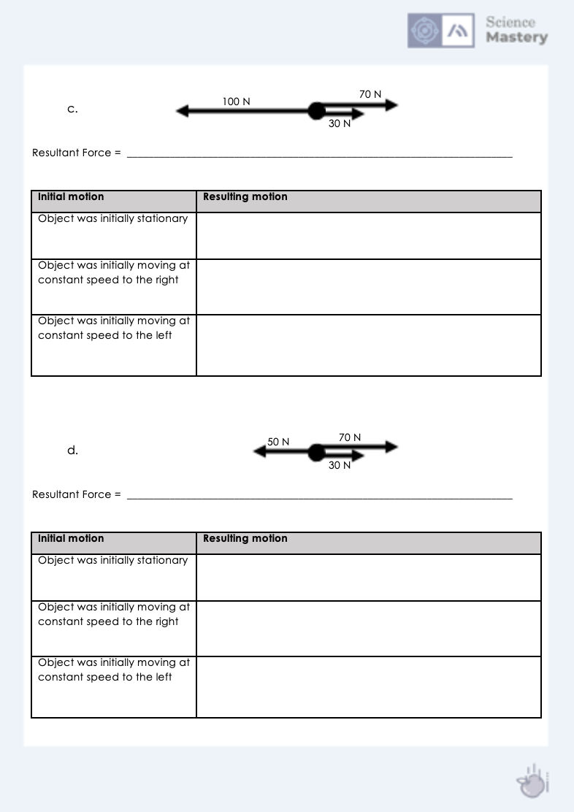
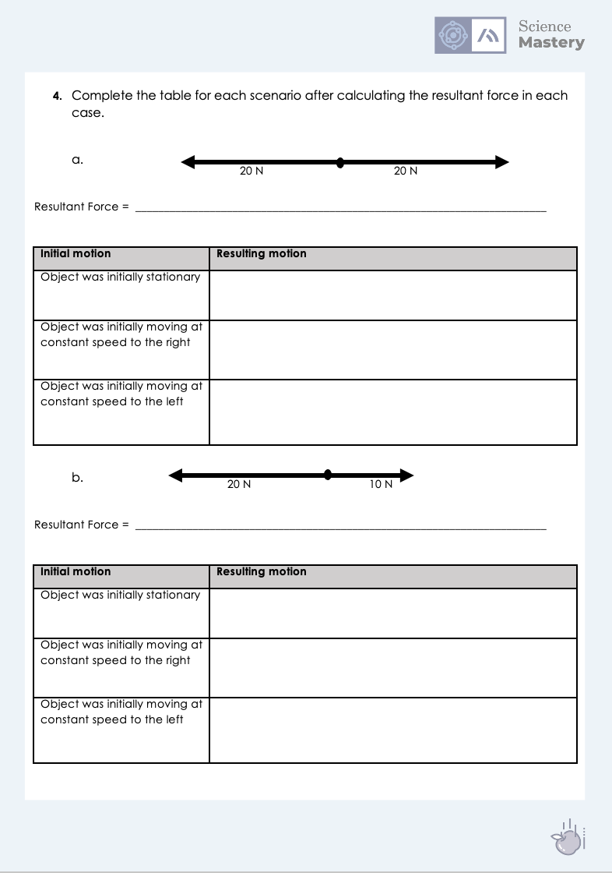
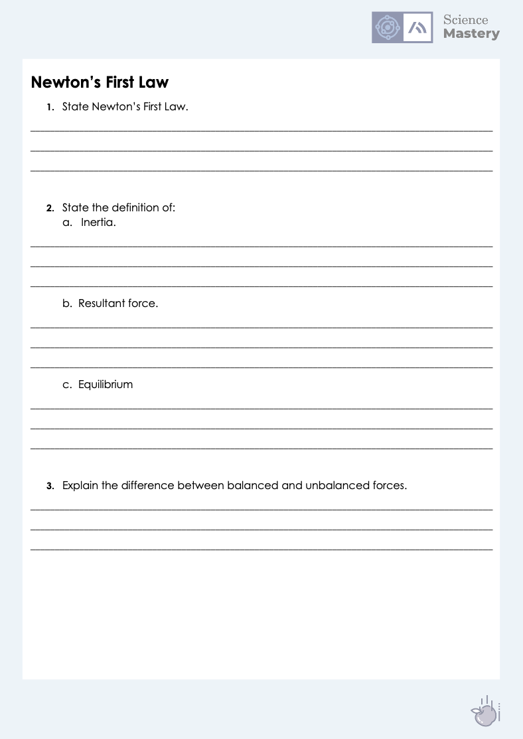
Newton’s First Law
Complete the worksheet on Newton’s First Law.
Calculate resultant forces, showing working.
Determine the motion of the different objects.
Notes:
Purpose: practice application of new knowledge.
You may want to split this worksheet up and discuss the questions before using the scenarios for independent practice.
Markscheme provided to self/peer assess answers.
Stretch – ask pupils to write their own scenarios as questions for others.

Slide 17
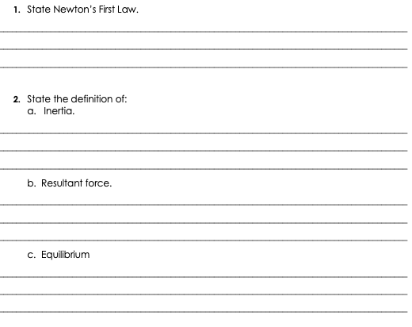
Answers
Newton’s First Law states that an objects motion will not change unless acted upon by an unbalanced force.
The tendency of objects to resist change to their motion.
The net force/overall effect of all the forces acting on an object.
When all the force acting upon an object are equal/balanced.

Slide 18
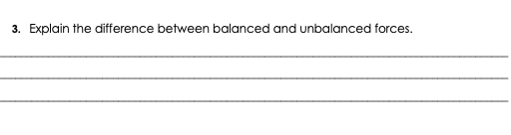
Answers
Balanced forces combine to make a resultant force of 0 N, unbalanced forces do not cancel each other out/make a non-zero resultant force.

Slide 19
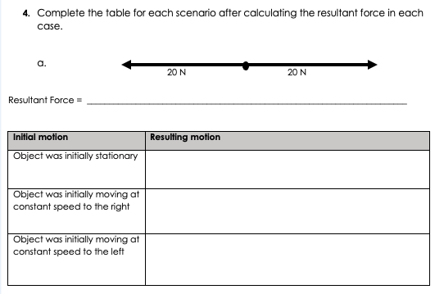
Answers
20 N – 20 N = 0 N
Object remains stationary
Object continues moving at constant speed to the right
Object continues moving at constant speed to the left

Slide 20
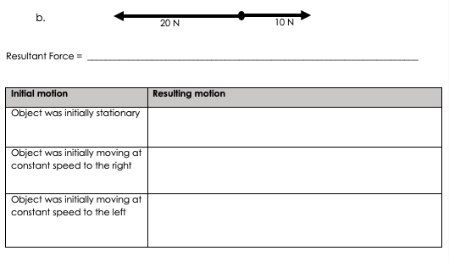
Answers
20 N – 10 N = 10 N left
Object will accelerate to the left
Object will accelerate towards the left. This does not mean it moves to the left. This means it will slow down but still be moving towards the right, until it comes to a stop.
Object will accelerate (speed up) to the left

Slide 21
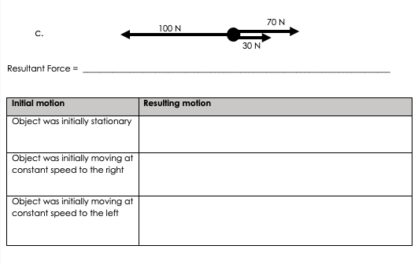
Answers
100 N – (70 N + 30 N) = 0 N
Object remains stationary
Object continues moving at constant speed to the right
Object continues moving at constant speed to the left

Slide 22
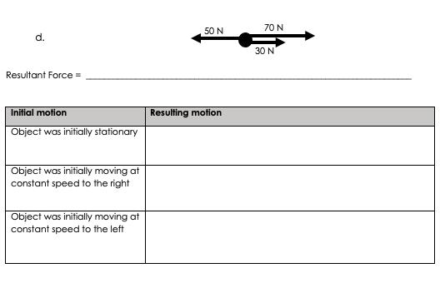
Answers
(70 N + 30 N) – 50 N = 50 N right
Object will accelerate towards the right
Object will accelerate (speed up) towards the right
Object will accelerate towards the right. This does not mean it moves to the right. This means it will slow down but still be moving towards the left, until it comes to a stop.

Slide 23
Answer the questions below.
1. Newton’s First Law states that …
A. Objects’ motion will not change unless acted upon by an unbalanced force
B. Objects will remain stationary if they are acted upon by an unbalanced force
C. Every action has an equal and opposite reaction
2. An object that is moving at 0.5 m/s to the right is acted upon by a resultant force of 5 N left. Which best describes its resulting motion?
A. It will move at 0.5 m/s to the left
B. It will now be stationary
C. It will slow down but continue moving towards the right
3. Which of these resultant forces would cause a stationary object to accelerate to the left?
A. 0 N
B. 5 N left
C. 5 N right
✓
✓
✓
Notes:
Suggested Guidance:
Q1. Answer: A
If students answered B or C, they need to be clearer on the exact definition of Newton’s First Law. To fix-it, It may be useful to refer back to the knowledge organiser to highlight Newton’s Laws or rephrase the laws and get pupils to determine which is which.
Q2. Answer: C
If students answered A, they have understood that the acceleration now acts towards the left but not applied that to an object that is already acting left. If students answered B, they may assume that any force acting in the opposite direction automatically stops the current motion. To fix-it it may be useful to show more real life examples of Newton’s First Law. A good example to use is with a car because all pupils will have experienced a car accelerating and decelerating. It may be useful to get pupils to draw force diagrams of driving force (thrust) vs brakes:
Car is stationary when there is no driving force or break → balanced forces
Car accelerates forwards when accelerator/thrust is applied – resultant force is forwards because thrust is greater than braking force.
Car slows down when brakes are applied – it does not start moving backwards! The resultant force is acting backwards but it slows the car down rather than changing its direction.
Q3. Answer: B
If students answered A or C, they have not been able to apply Newton’s First Law. To fix-it, it may be useful to provide further scenarios where objects are either stationary or already moving with different resultant forces acting on them.

Slide 24
Lesson P3.1.6
What was good about this lesson? | What can we do to improve this lesson?
Send us your feedback by clicking this link
or by emailing sciencemastery@arkonline.org
Thank you!

